Slide 1
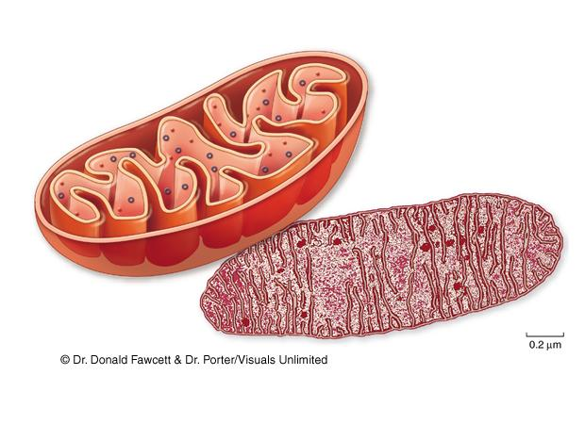
How Cells Harvest Energy
Chapter 7

Slide 2
Laws of Thermodynamics
Most reactions require some energy to get started.
activation energy: extra energy needed to get a reaction started
-destabilizes existing chemical bonds
-required even for exergonic reactions
catalysts: substances that lower the activation energy of a reaction

Slide 3
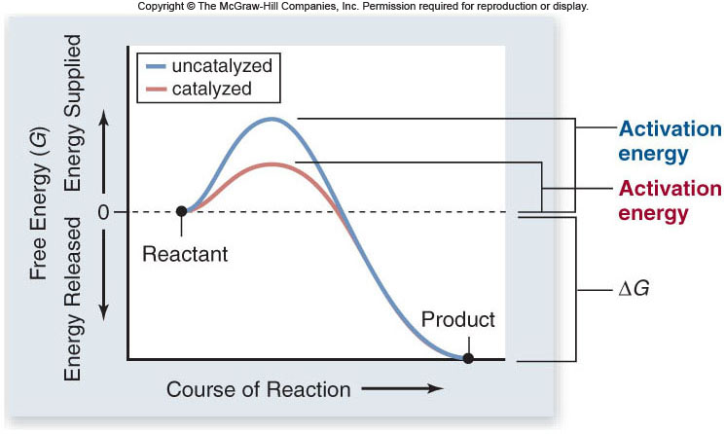

Slide 4
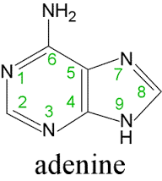
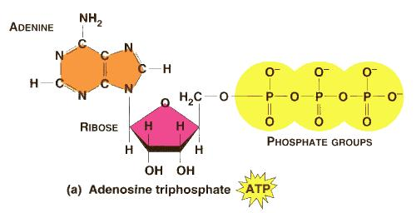
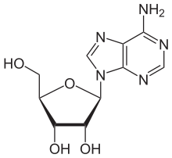
Energy Currency of Cells
ATP = adenosine triphosphate
-the energy “currency” of cells
ATP structure:
-ribose, a 5-carbon sugar
-adenine
-three phosphates

Slide 5
Respiration
Organisms can be classified based on how they obtain energy:
autotrophs: are able to produce their own organic molecules through photosynthesis
heterotrophs: live on organic compounds produced by other organisms
All organisms use cellular respiration to extract energy from organic molecules.

Slide 6
Respiration
Cellular respiration is a series of reactions that:
-are oxidations – loss of electrons
-are also dehydrogenations – lost electrons are accompanied by hydrogen
Therefore, what is actually lost is a hydrogen atom (1 electron, 1 proton).

Slide 7
Respiration
Free energy: the energy available to do work
-denoted by the symbol G (Gibb’s free energy)
enthalpy: energy contained in a molecule’s chemical bonds
free energy = enthalpy – (entropy x temp.)
G = H - TS

Slide 8
Respiration
During redox reactions, electrons carry energy from one molecule to another.
NAD⁺ is an electron carrier.
-NAD accepts 2 electrons and 1 proton to become NADH
-the reaction is reversible

Slide 9
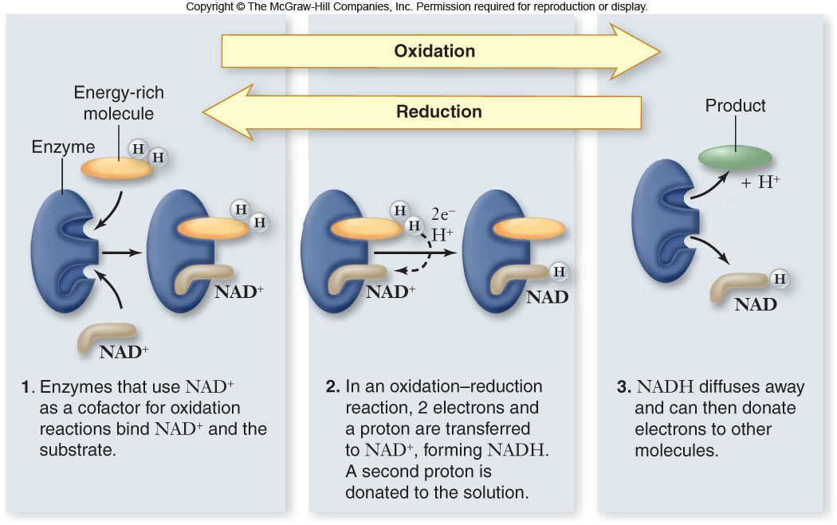

Slide 10
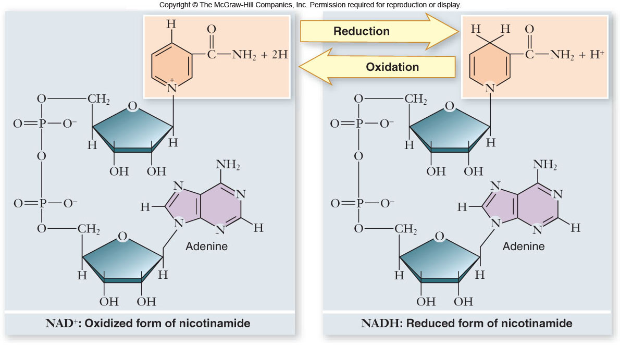

Slide 11
Respiration
During respiration, electrons are shuttled through electron carriers to a final electron acceptor.
aerobic respiration: final electron receptor is oxygen (O₂)
anaerobic respiration: final electron acceptor is an inorganic molecule (not O₂)
fermentation: final electron acceptor is an organic molecule

Slide 12
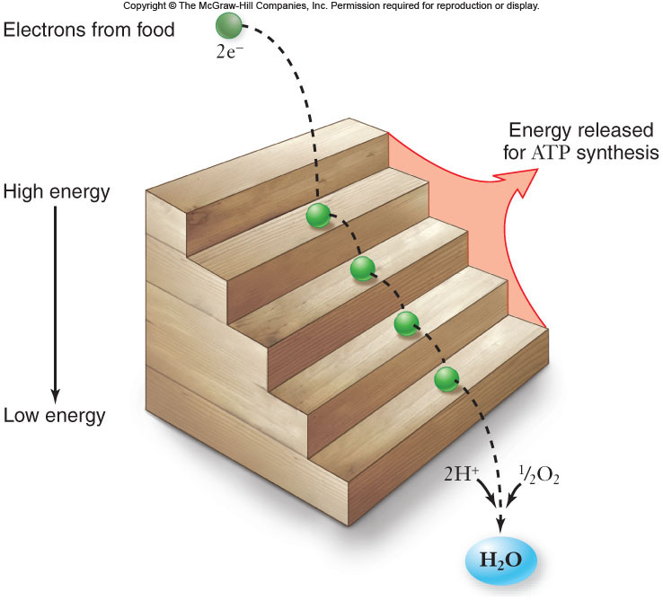
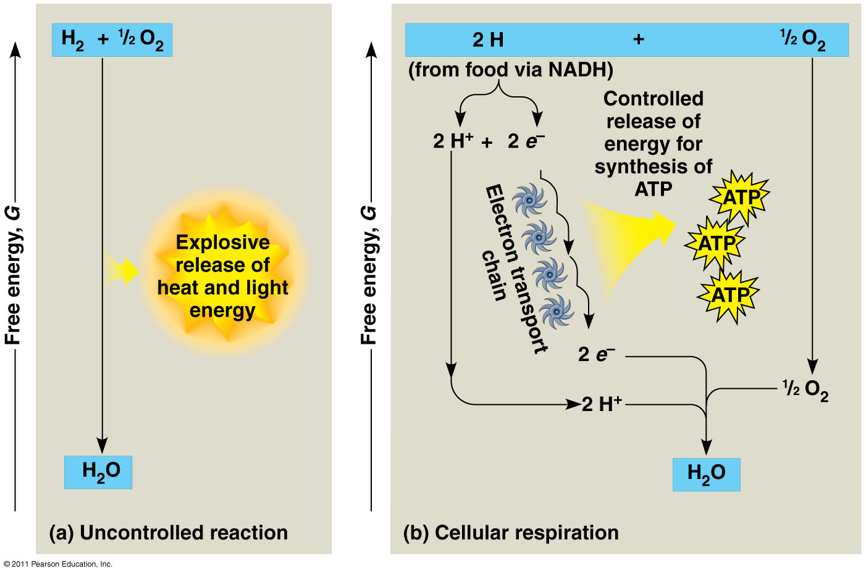
Energy Harvest
Energy is released as electrons “fall” from organic molecules to O₂
Broken down into steps:
Food (Glucose) → NADH → ETC → O₂
  Coenzyme NAD⁺ = electron acceptor
  NAD⁺ picks up 2e⁻ and 2H⁺ → NADH (stores E)
  NADH carries electrons to the electron transport chain (ETC)
  ETC: transfers e⁻ to O₂ to make H₂O ; releases energy

Slide 13
Respiration
Aerobic respiration:
C₆H₁₂O₆ + 6O₂ + 6H₂O → 6CO₂ + 12H₂O
ΔG = -686kcal/mol of glucose
ΔG can be even higher than this in a cell
This large amount of energy must be released in small steps rather than all at once.

Slide 14
Oxidation of Glucose
Cells are able to make ATP via:
1. substrate-level phosphorylation – transferring a phosphate directly to ADP from another molecule
2. oxidative phosphorylation – use of ATP synthase and energy derived from a proton (H⁺) gradient to make ATP

Slide 15
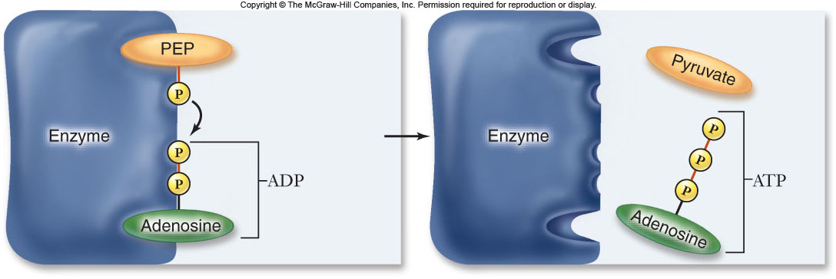

Slide 16
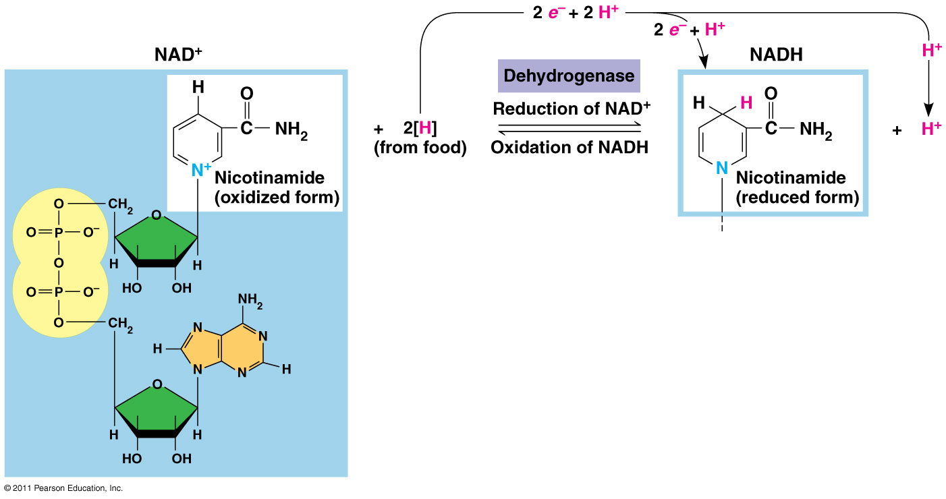
Respiration
During redox reactions, electrons carry energy from one molecule to another.
NAD⁺ is an electron carrier.
NAD+ accepts 2 electrons and 1 proton to become NADH
the reaction is reversible

Slide 17
Oxidation of Glucose
The complete oxidation of glucose proceeds in stages:
1. glycoloysis
2. pyruvate oxidation
3. Krebs cycle
4. electron transport chain & chemiosmosis

Slide 18
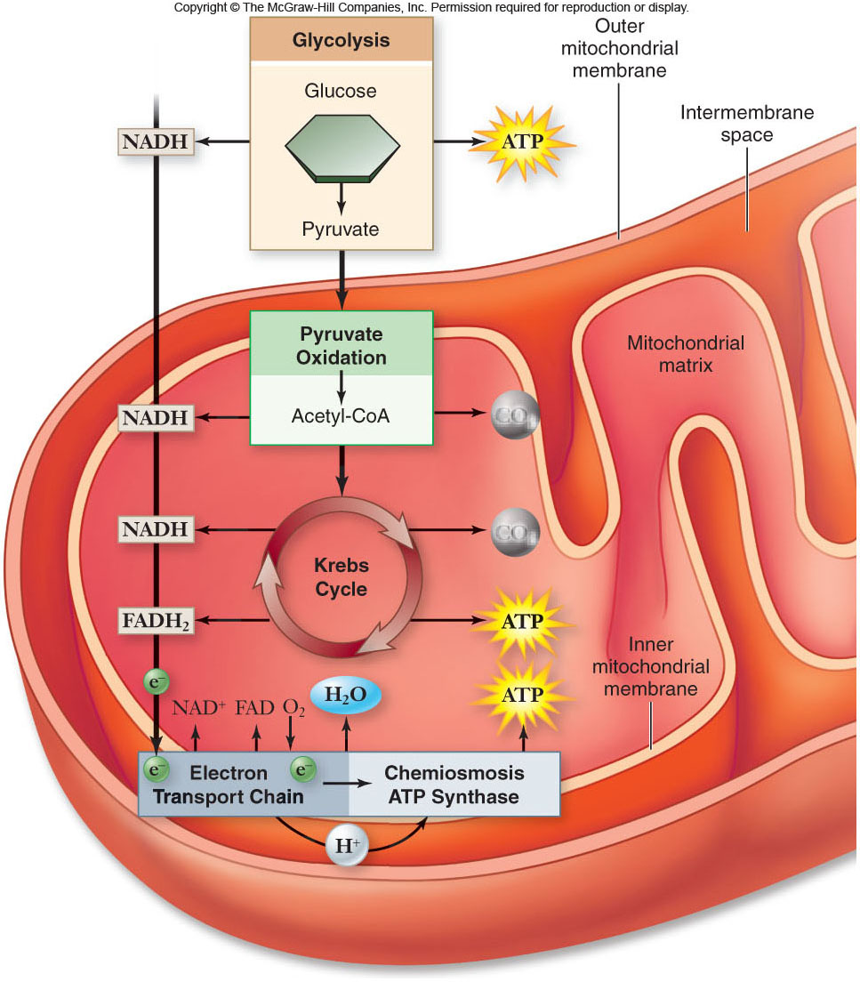

Slide 19
Glycoloysis
As you can see that Glycolysis is a series of chemical reactions that changes Glucose, one step at a time, into Different Molecules.
1. It starts with Glucose or a Monosaccharide
2. C₆H₁₂O₆ ; Split the sugar using up two ATP to form 2 PGAL= 3Carbon compound
3. Energy from the 2 PGAL forms 4 ADP and 2 NADH.

Slide 20
Glycoloysis
4. 4 ADP forms into 4 ATP by phosphorylation.
This uses 2 ATP.
5. That is a Net gain of 2 ATP in Glycolysis
And Pyruvic Acid.
Glycolysis is an Anerobic Phase!! No O₂ requirement.

Slide 21
Glycoloysis
Glycoloysis converts glucose to pyruvate.
-a 10-step biochemical pathway
-occurs in the cytoplasm
-2 molecules of pyruvate are formed
-net production of 2 ATP molecules by substrate-level phosphorylation
-2 NADH produced by the reduction of NAD⁺

Slide 22
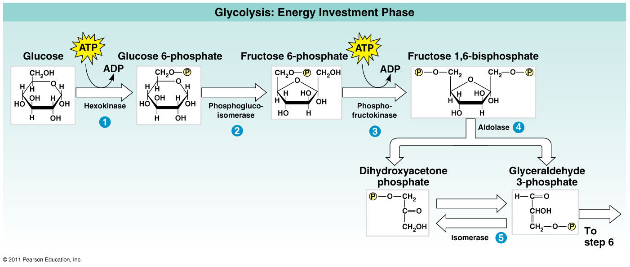
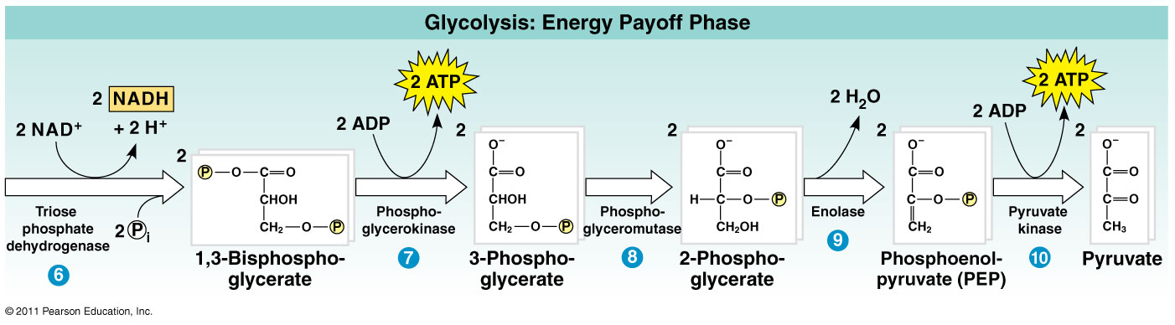

Slide 23
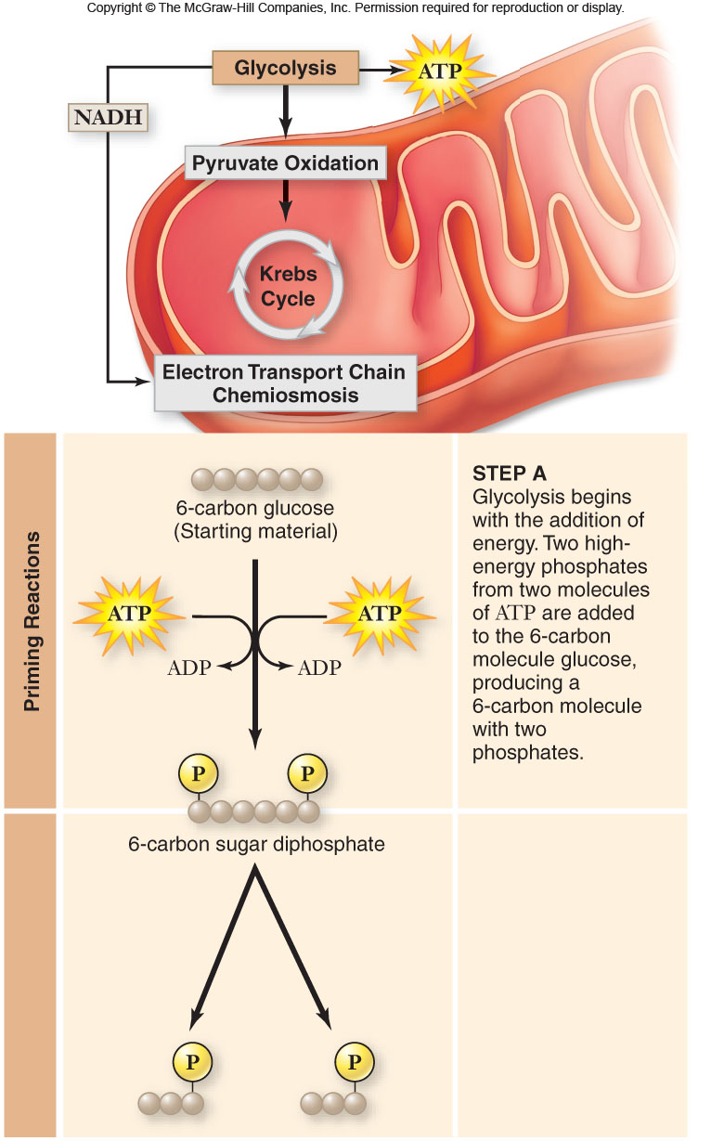
1. Glucose:
2.6 Carbon Sugar PGAL

Slide 24
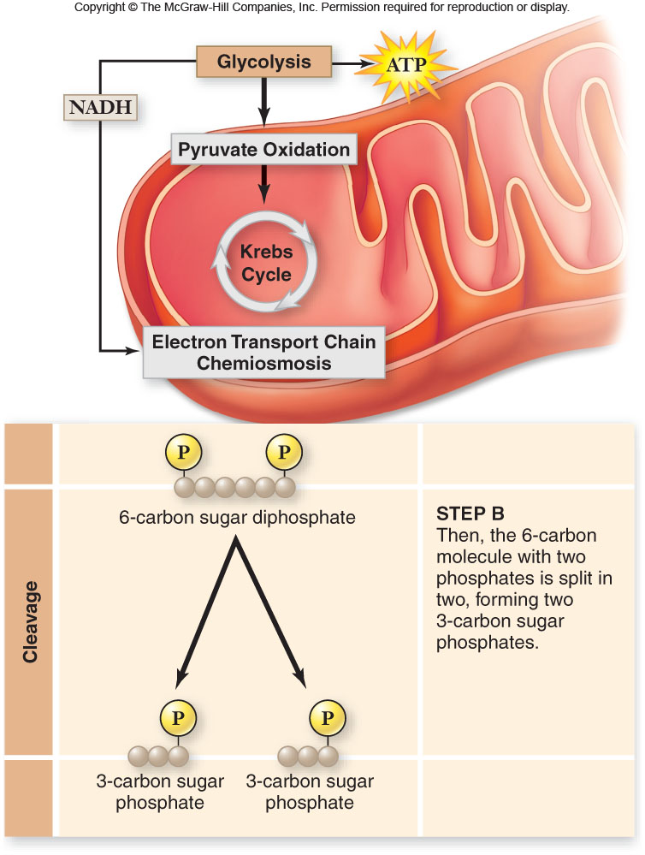

Slide 25
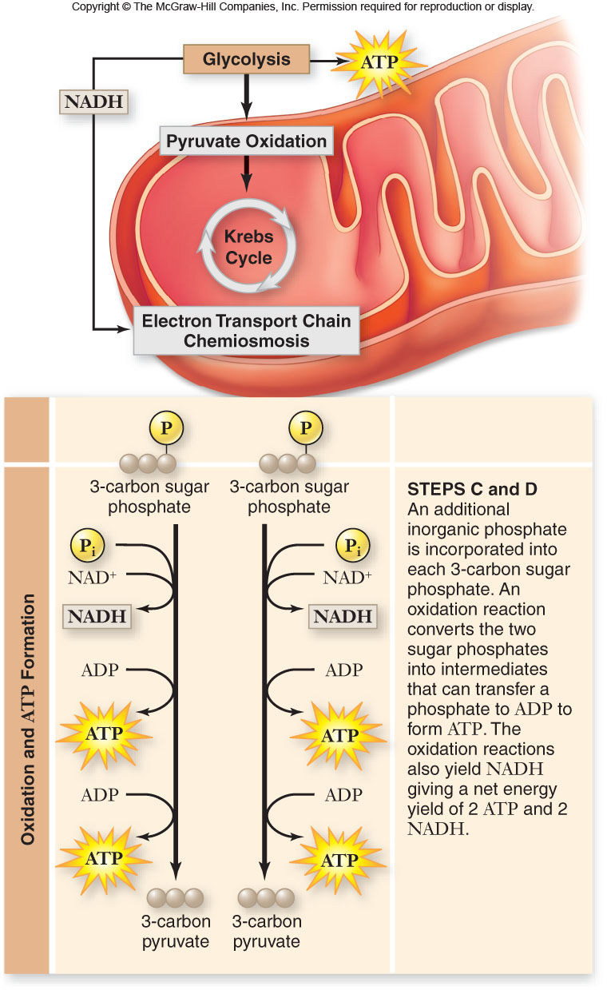

Slide 26
Glycolysis
The fate of pyruvate depends on oxygen availability.
When oxygen is present, pyruvate is oxidized to acetyl-CoA which enters the Krebs cycle
Without oxygen, pyruvate is reduced in order to oxidize NADH back to NAD⁺

Slide 27
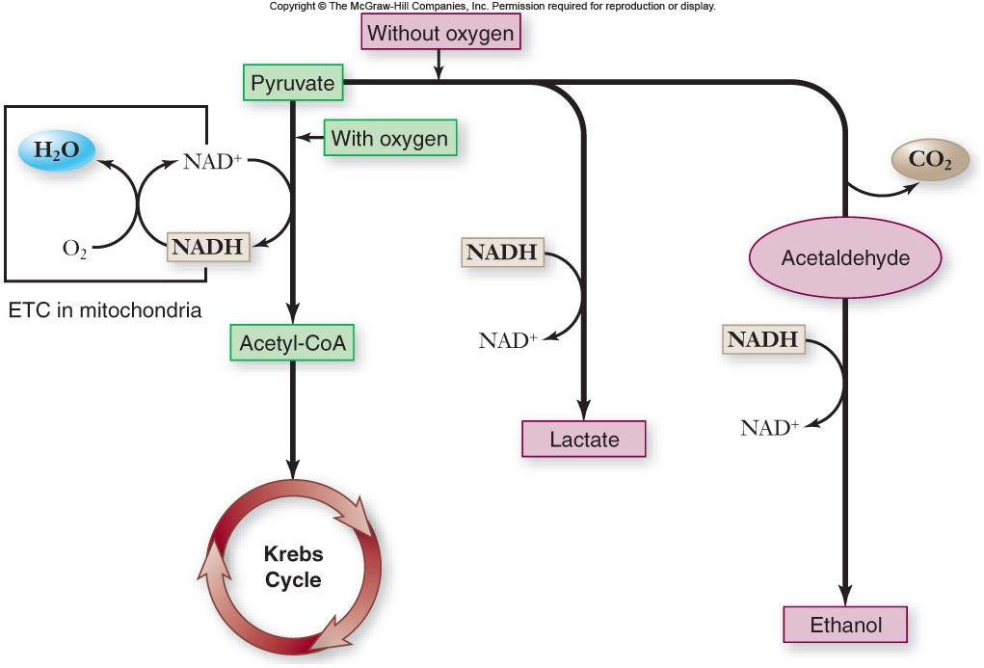

Slide 28
Pyruvate Oxidation
In the presence of oxygen, pyruvate is oxidized.
-occurs in the mitochondria in eukaryotes
-occurs at the plasma membrane in prokaryotes
-in mitochondria, a multienzyme complex called pyruvate dehydrogenase catalyzes the reaction

Slide 29
Pyruvate Oxidation
The products of pyruvate oxidation include:
-1 CO₂
-1 NADH
-1 acetyl-CoA which consists of 2 carbons from pyruvate attached to coenzyme A
Acetyl-CoA proceeds to the Krebs cycle.

Slide 30
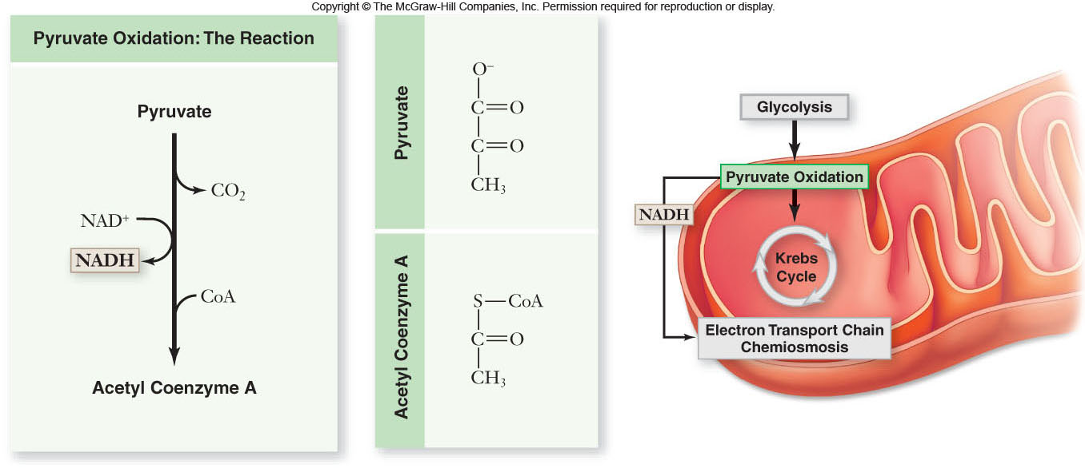

Slide 31
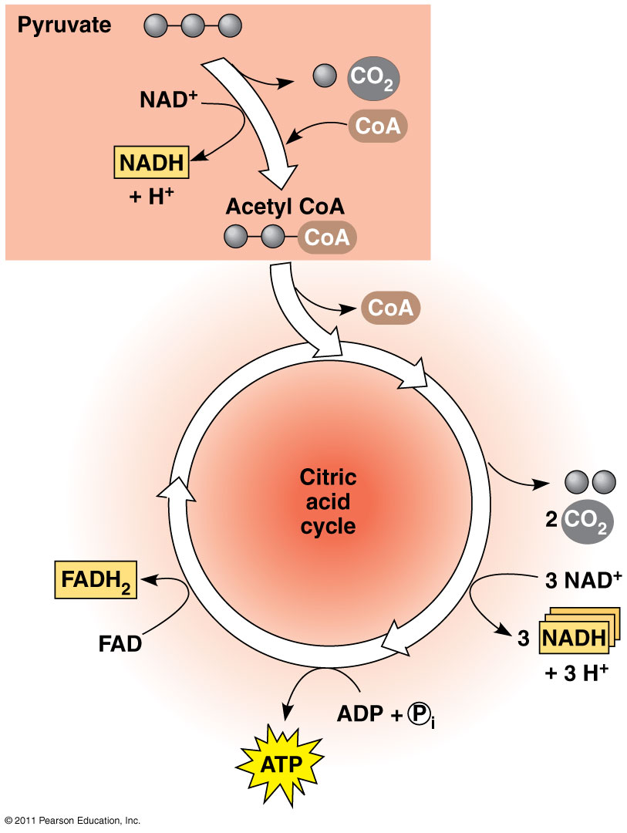
Citric Acid Cycle (Krebs)
Occurs in mitochondrial matrix
Acetyl CoA → Citrate →released
Net gain: 2 ATP, 6 NADH, 2 FADH₂ (electron carrier)
ATP produced by substrate-level phosphorylation
CO₂

Slide 32
Krebs Cycle
The Krebs cycle oxidizes the acetyl group from pyruvate.
-occurs in the matrix of the mitochondria
-biochemical pathway of 9 steps
-first step:
acetyl group + oxaloacetate citrate
(2 carbons) (4 carbons) (6 carbons)

Slide 33
Krebs Cycle
The remaining steps of the Krebs cycle:
-release 2 molecules of CO₂
-reduce 3 NAD⁺ to 3 NADH
-reduce 1 FAD (electron carrier) to FADH₂
-produce 1 ATP
-regenerate oxaloacetate

Slide 34
Krebs Cycle
Acetyl Coenzyme A Produced in Glycolysis is added to a 4 carbon compound to produce a 6 carbon compound. (Citric Acid.)
Several Step Sequence of electron yielding reactions. NAD+ to NADH forming 2 CO₂ and a 4 Carbon Compound.
Phosphorylation of a GDP to GTP. This GTP can then transfer a Phosphate to ADP forming ATP.

Slide 35
Krebs Cycle
After glycolysis, pyruvate oxidation, and the Krebs cycle, glucose has been oxidized to:
- 6 CO₂
- 4 ATP
- 10 NADH
- 2 FADH₂
These electron carriers proceed
to the electron transport chain.

Slide 36
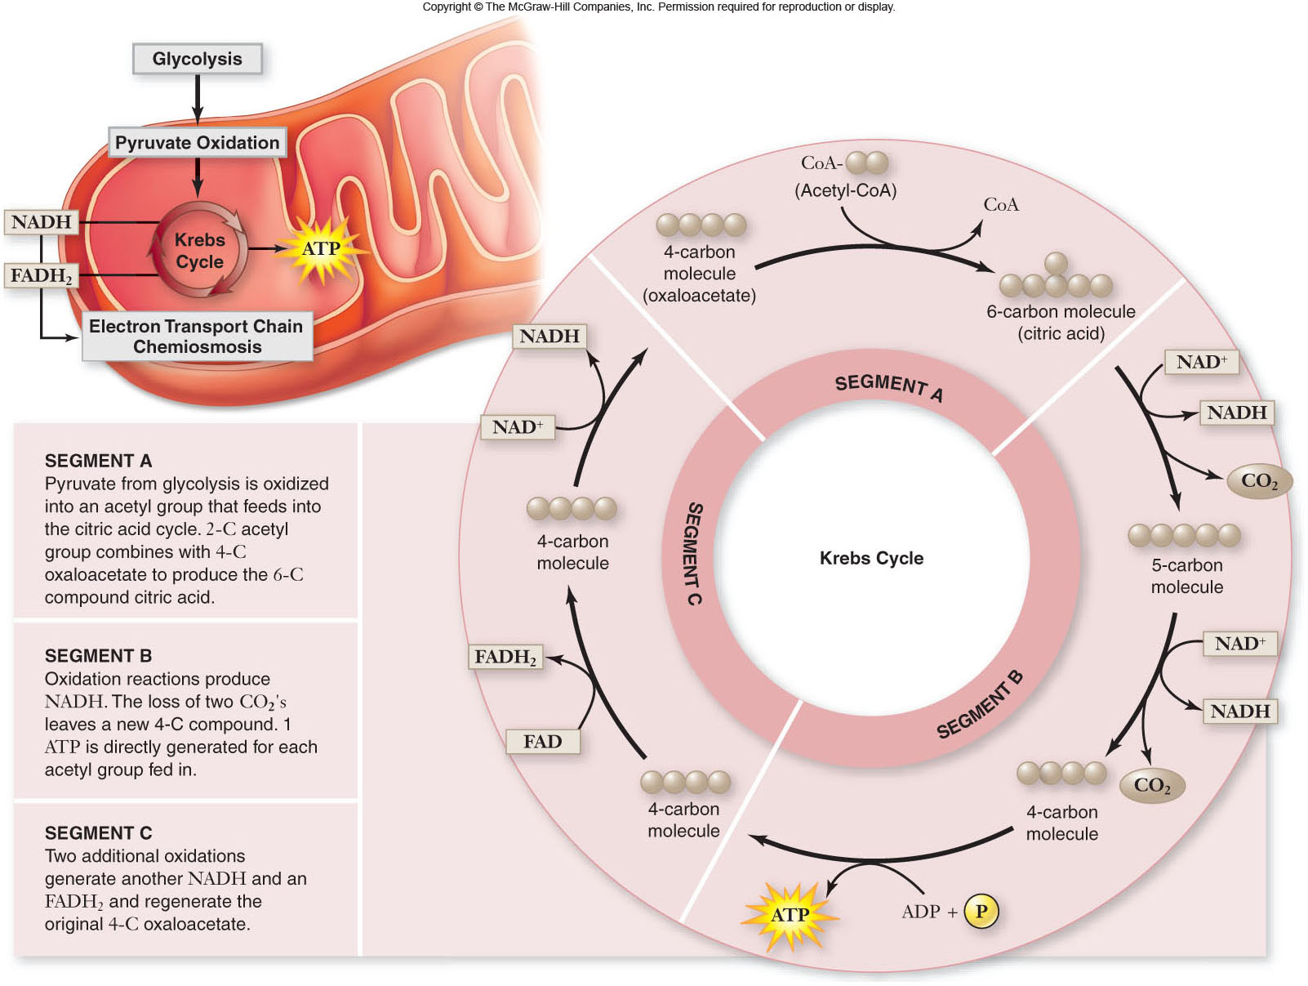

Slide 37
4. The 4 Carbon Compound is Oxidized by FAD to FADH₂. Not enough Free energy to reduce NAD+. FADH contributes electrons for the Electron transport chain.
5. Water is added to form Malate. Malate is oxidized to form Oxaloacetate (4Carbon). NAD+ is reduced to form NADH.

Slide 38
Electron Transport Chain
The electron transport chain (ETC) is a series of membrane-bound electron carriers.
-embedded in the mitochondrial inner membrane
-electrons from NADH and FADH₂ are transferred to complexes of the ETC
-each complex transfers the electrons to the next complex in the chain

Slide 39
Stage 4: Oxidative Phosphorylation
Electron Transport Chain
Chemiosmosis
Occurs in inner membrane of mitochondria
Produces 26-28 ATP by oxidative phosphorylation via chemiosmosis
H⁺ ions pumped across inner mitochondrial membrane
H⁺ diffuse through ATP synthase (ADP → ATP)

Slide 40
Electron Transport Chain
As the electrons are transferred, some electron energy is lost with each transfer.
This energy is used to pump protons (H⁺) across the membrane from the matrix to the inner membrane space.
A proton gradient is established.

Slide 41
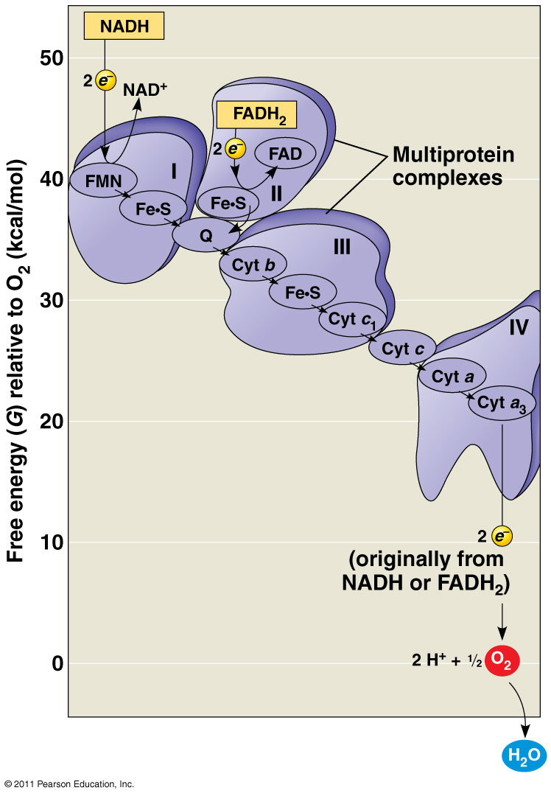
Electron Transport Chain (ETC)
Collection of molecules embedded in inner membrane of mitochondria
Tightly bound protein + non-protein components
Alternate between reduced/oxidized states as accept/donate e⁻
Does not make ATP directly
Ease fall of e- from food to O₂
2H⁺ + ½ O₂ → H₂O

Slide 42
Electron Transport Chain
The electron transport chain (ETC) is a series of membrane-bound electron carriers.
-embedded in the mitochondrial inner membrane
-electrons from NADH and FADH₂ are transferred to complexes of the ETC
-each complex transfers the electrons to the next complex in the chain

Slide 43
Energy Yield of Respiration
theoretical energy yields
- 38 ATP per glucose for bacteria
- 36 ATP per glucose for eukaryotes
actual energy yield
- 30 ATP per glucose for eukaryotes
- reduced yield is due to “leaky” inner membrane and use of the proton gradient for purposes other than ATP synthesis

Slide 44
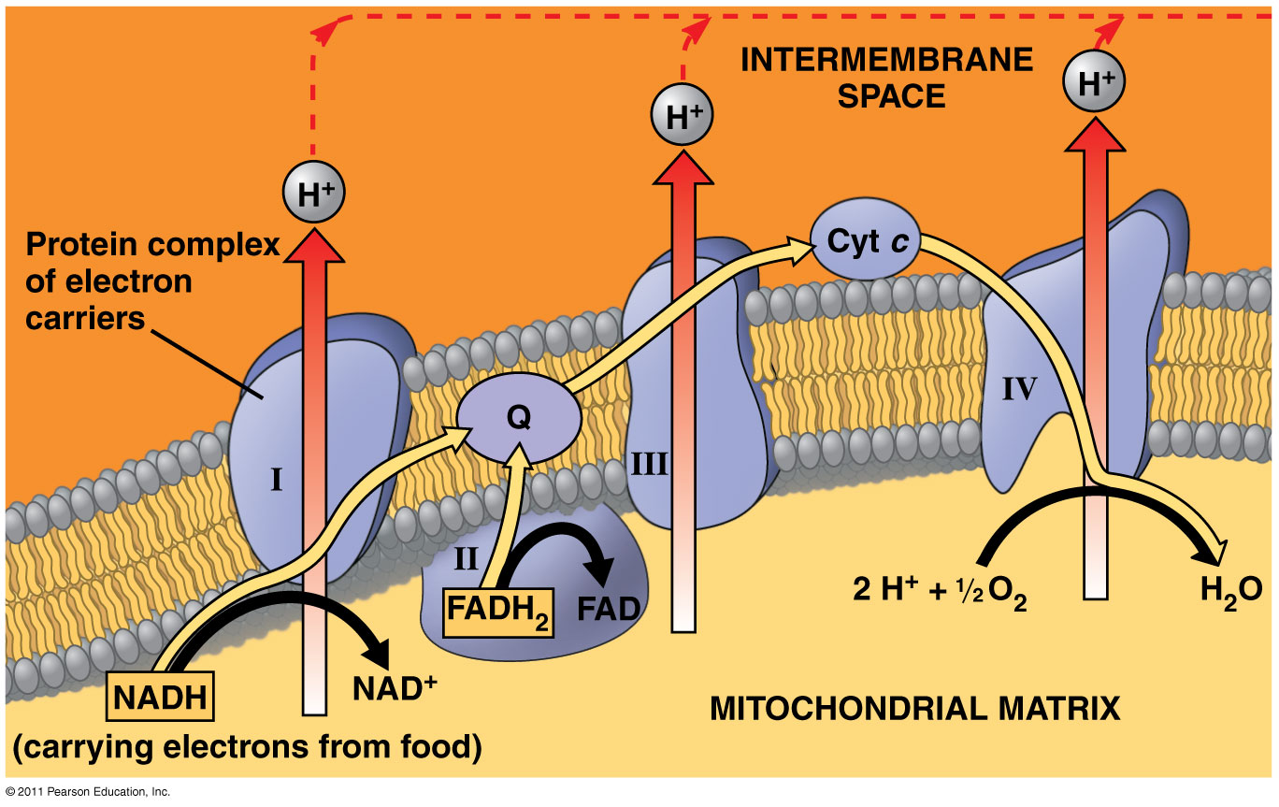
As electrons move through the ETC, proton pumps move H⁺ across inner mitochondrial membrane

Slide 45
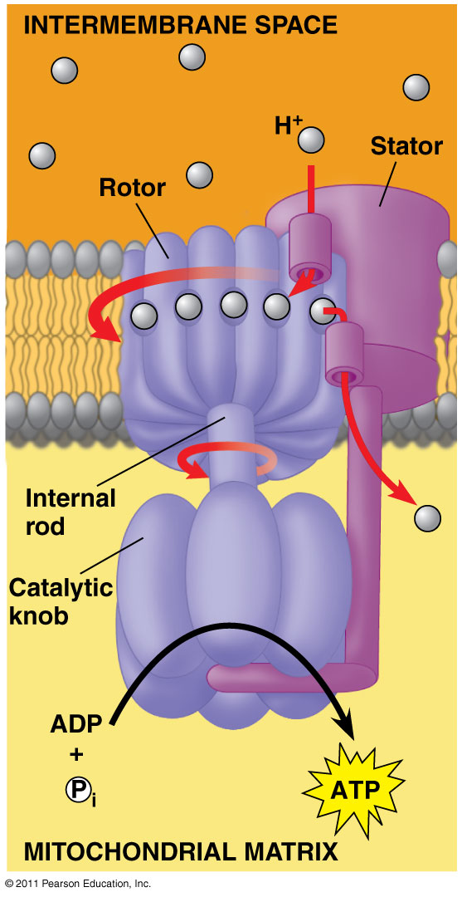
Chemiosmosis: Energy-Coupling Mechanism
Chemiosmosis = H⁺ gradient across membrane drives cellular work
Proton-motive force: use proton (H⁺) gradient to perform work
ATP synthase: enzyme that makes ATP
Use E from proton (H⁺) gradient – flow of H⁺ back across membrane

Slide 46
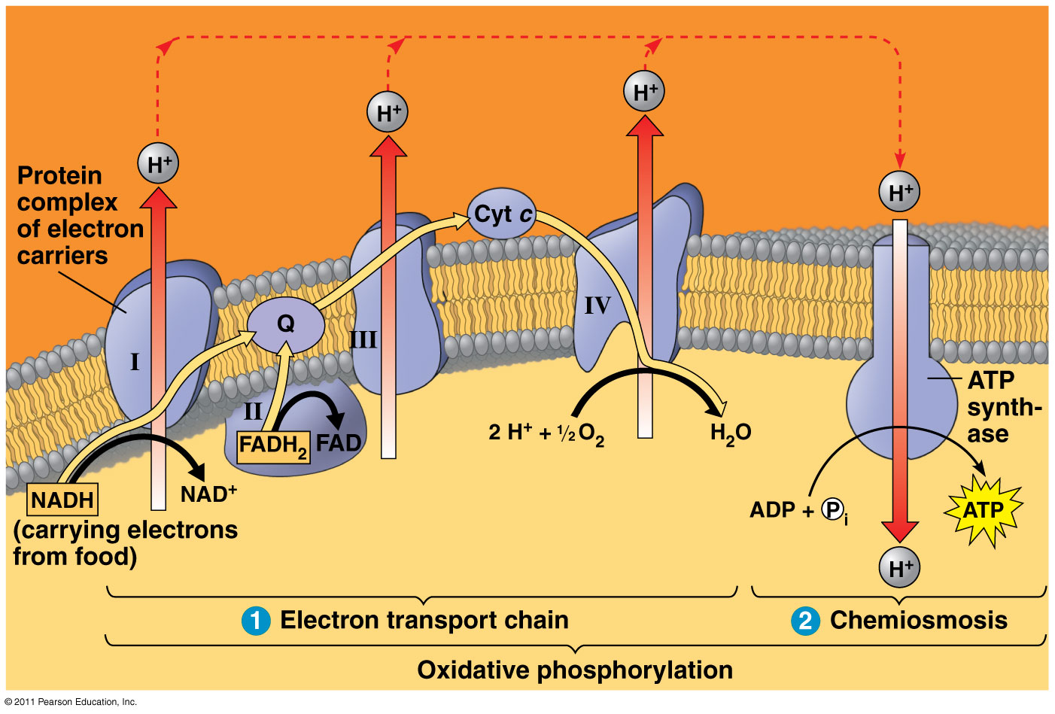
Chemiosmosis couples the ETC to ATP synthesis

Slide 47
oxidative phosphorylation
uses
generates
chemiosmosis
which couples
ATP
proton gradient
uses E
to produce
called
redox reactions
H+ pumped from matrix to intermembrane space
proton motive force
of
ETC
drives
in which
H⁺
e- passed down E levels
through
ATP synthase
to final e- acceptor
O₂ → H₂O

Slide 48
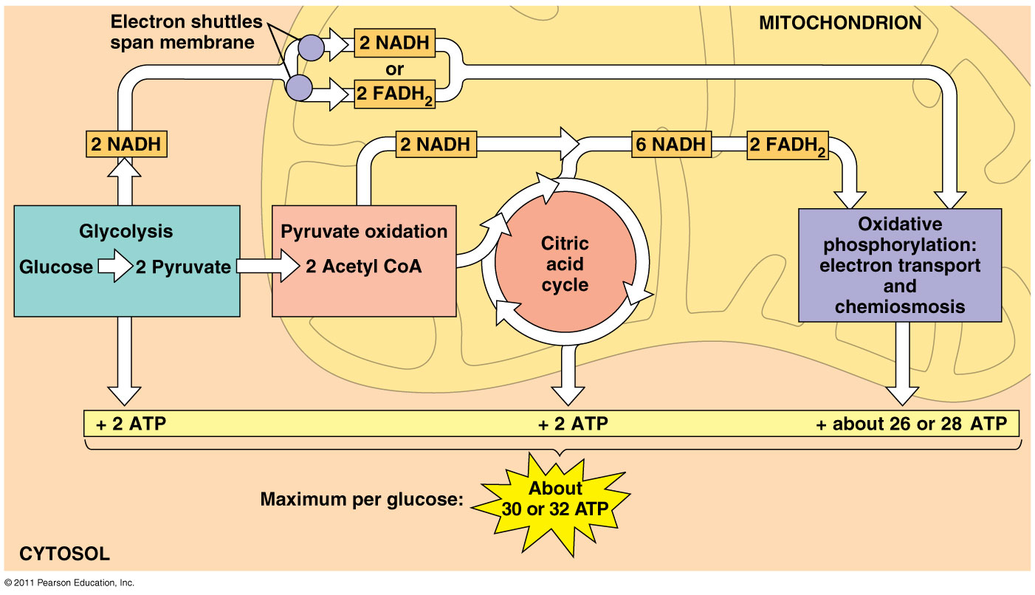
ATP yield per molecule of glucose at each stage of cellular respiration

Slide 49
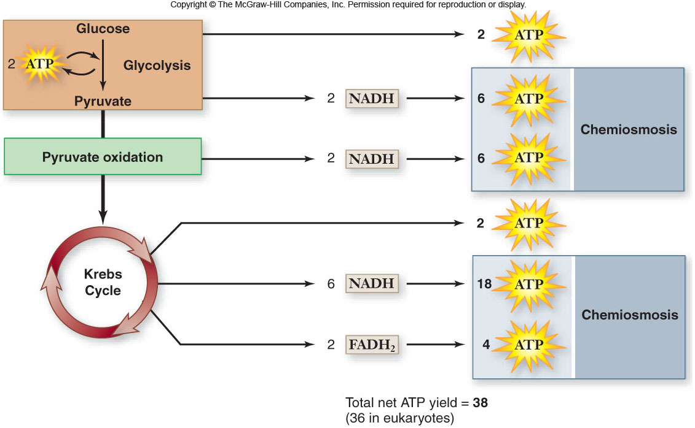

Slide 50
Respiration Overview
The Process that involves the breakdown of Food molecules such as Glucose to Release energy.
Pyruvate used in Glycolysis is Broken down and 34 ATP are formed. Oxygen is needed to release the energy and the chemical reactions occur in the Mitochondria of the cell.

Slide 51
Anaerobic Respiration: generate ATP using other electron acceptors besides O₂
  Final e⁻ acceptors: sulfate (SO₄), nitrate, sulfur (produces H₂S)
  Eg. Obligate anaerobes: can’t survive in O₂
Facultative anaerobes: make ATP by aerobic respiration (with O₂ present) or switch to fermentation (no O₂ available)
  Eg. human muscle cells

Slide 52
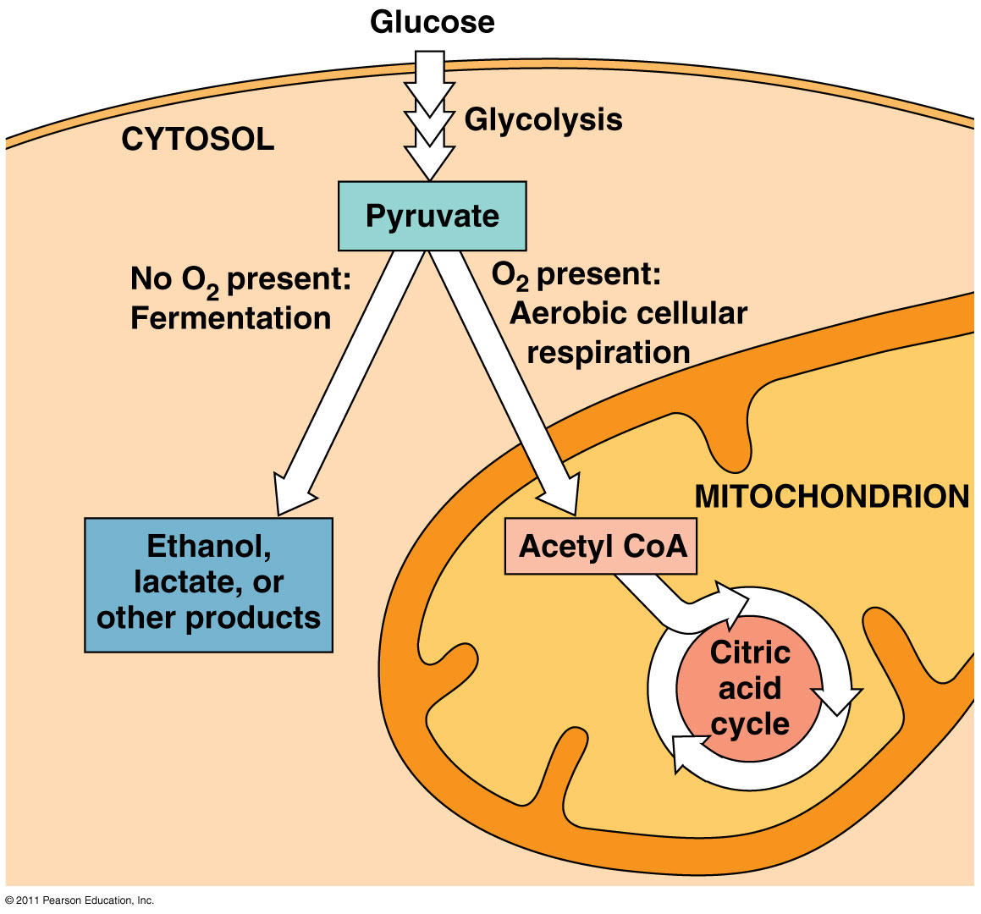
Fermentation = glycolysis + regeneration of NAD⁺

Slide 53
Glycolysis
Without O₂
O₂ present
Fermentation
Respiration
Keep glycolysis going by regenerating NAD⁺
Occurs in cytosol
No oxygen needed
Creates ethanol [+ CO₂] or lactate
2 ATP (from glycolysis)
Release E from breakdown of food with O₂
Occurs in mitochondria
O₂ required (final electron acceptor)
Produces CO₂, H₂O and up to 32 ATP

Slide 54
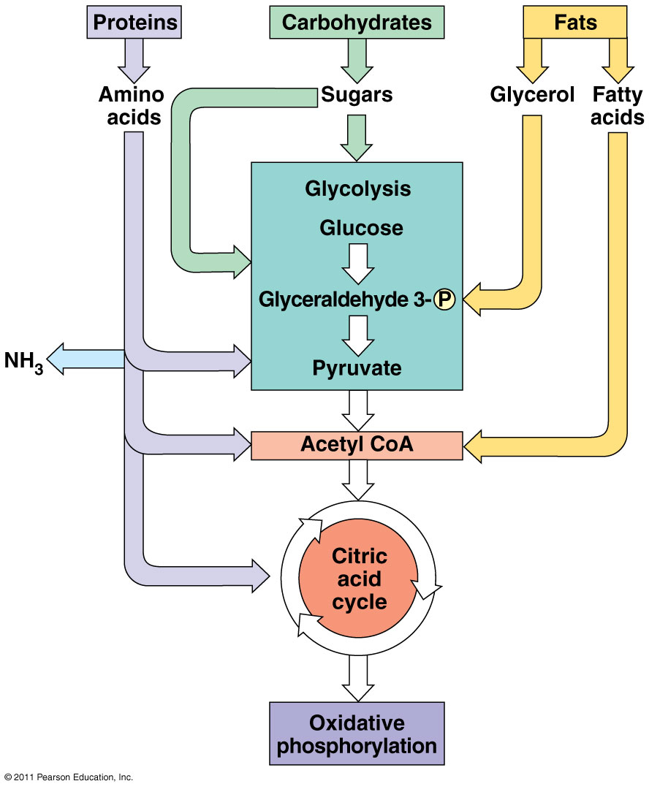
Various sources of fuel
Carbohydrates, fats and proteins can ALL be used as fuel for cellular respiration
Monomers enter glycolysis or citric acid cycle at different points

Slide 55
Types of Fermentation
Alcohol fermentation
Lactic acid fermentation
Pyruvate → Ethanol + CO₂
Ex. bacteria, yeast
Used in brewing, winemaking, baking
Pyruvate → Lactate
Ex. fungi, bacteria, human muscle cells
Used to make cheese, yogurt, acetone, methanol
Note: Lactate build-up does NOT causes muscle fatigue and pain (old idea)

Slide 56
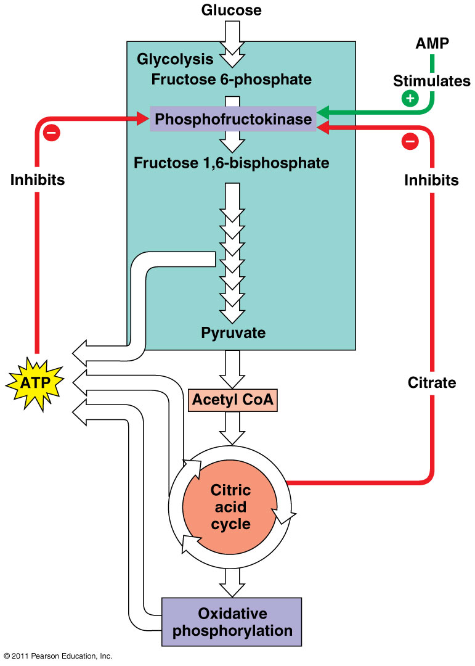
Phosphofructokinase:
Allosteric enzyme that controls rate of glycolysis and citric acid cycle
Inhibited by ATP, citrate
Stimulated by AMP
  AMP+ P + P →ATP

Slide 57
Energy production and Exercise
ATP and Creatine Phosphate produce enough energy for about 15 seconds of maximum muscle contraction.
After 15 second of exercise the muscle must go to glycolysis to find the energy.

Slide 58
Glycolysis:
This is the process of breaking down glucose into pyruvic acid ( Pyruvate) and 2 ATP.
Glucose passes easily to the muscle from the blood.
Glycolysis occurs in the sarcoplasm and is anaerobic..
It provides enough energy for the muscles 30 to 40 seconds.
After 40 sec. The muscle performs either lactic acid fermentation or aerobic cellular respiration if oxygen is present.

Slide 59
Aerobic Cellular Respiration
2 sources of oxygen used 1.) from Blood
2.) from Myoglobin
Used in activities that last more than 10 min.

Slide 60
If enough Oxygen is present Pyruvic acid enters the Mitochondria and is completely oxidized. This generates 36 ATP, carbon dioxide, water, and heat.
Lactic Acid Fermentation: If Oxygen levels are low the pyruvic acid that is made during glycolysis is converted to lactic acid

Slide 61
Respiration: Big Picture

Slide 62
ENERGY
aerobic cellular respiration
(with O₂)
anaerobic (without O₂)
glycolysis
(cytosol)
mitochondria
Fermentation
(cytosol)
pyruvate oxidation
ethanol + CO₂
(yeast, some bacteria)
citric acid cycle
substrate-level phosphorylation
lactic acid
(animals)
ETC
oxidative phosphorylation
chemiosmosis

Slide 63
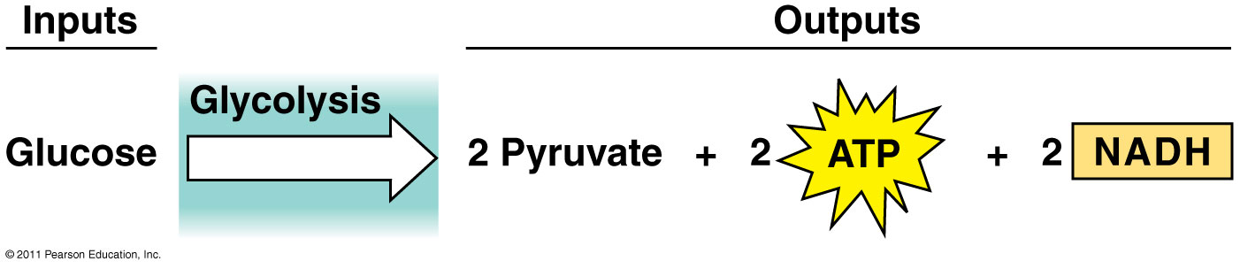
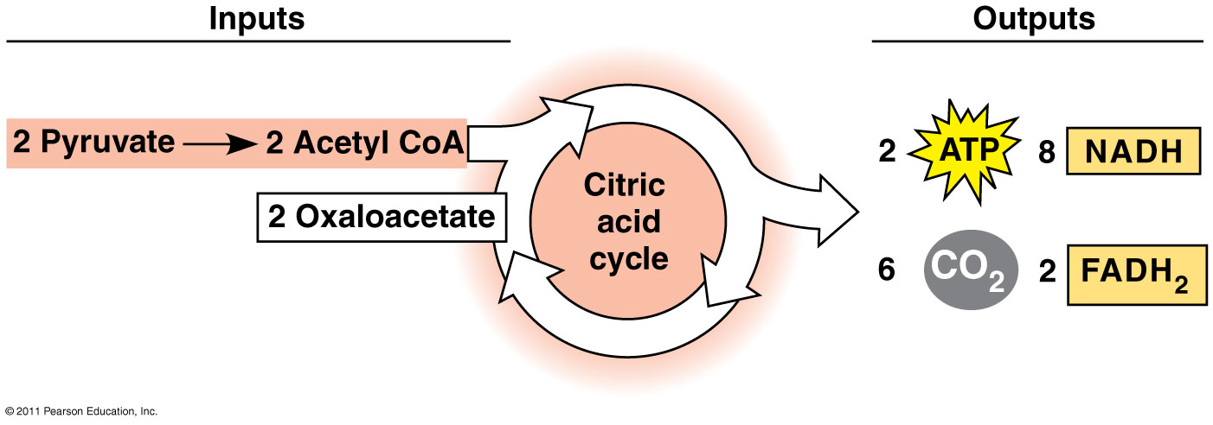
Glycolysis & Citric Acid Cycle

Slide 64
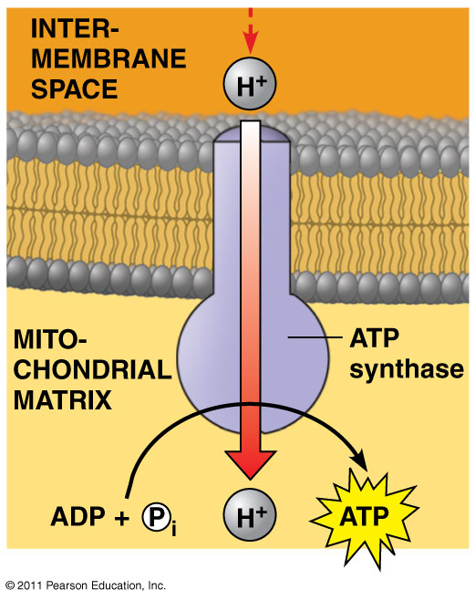
Oxidative Phosphorylation
Electron Transport Chain
Chemiosmosis

Slide 65
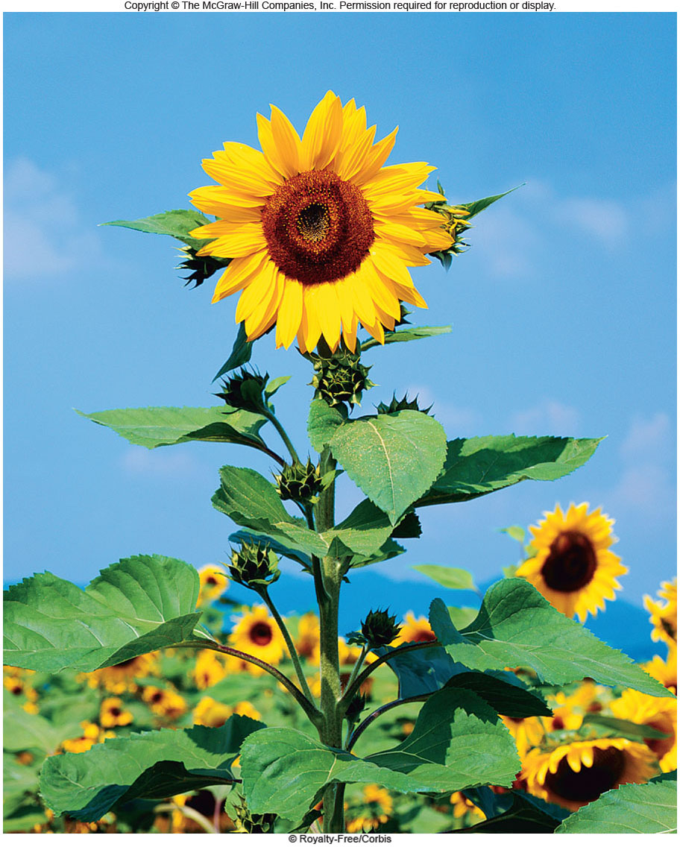
Photosynthesis
Chapter 8

Slide 66
Photosynthesis Overview
Energy for all life on Earth ultimately comes from photosynthesis.
6CO₂ + 12H₂O C₆H₁₂O₆ + 6H₂O + 6O₂
Oxygenic photosynthesis is carried out by:
cyanobacteria, 7 groups of algae,
all land plants

Slide 67
Photosynthesis is divided into:
light-dependent reactions
-capture energy from sunlight
-make ATP and reduce NADP⁺ to NADPH
carbon fixation reactions
-use ATP and NADPH to synthesize organic molecules from CO₂

Slide 68
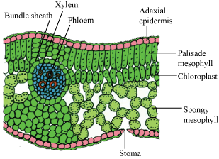
Plants Tissue
Mesophyll: This is the interior portion of a leaf. It contains the Chloroplasts.
Stomata: These are pores that allow material to move into and out of the plant cells.

Slide 69
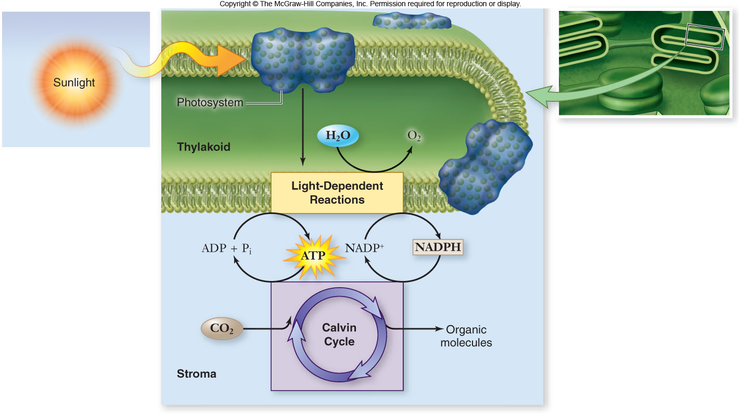

Slide 70
Photosynthesis Overview
Photosynthesis takes place in chloroplasts.
thylakoid membrane – internal membrane arranged in flattened sacs
-contain chlorophyll and other pigments
grana – stacks of thylakoid membranes
stroma – semiliquid substance surrounding thylakoid membranes

Slide 71
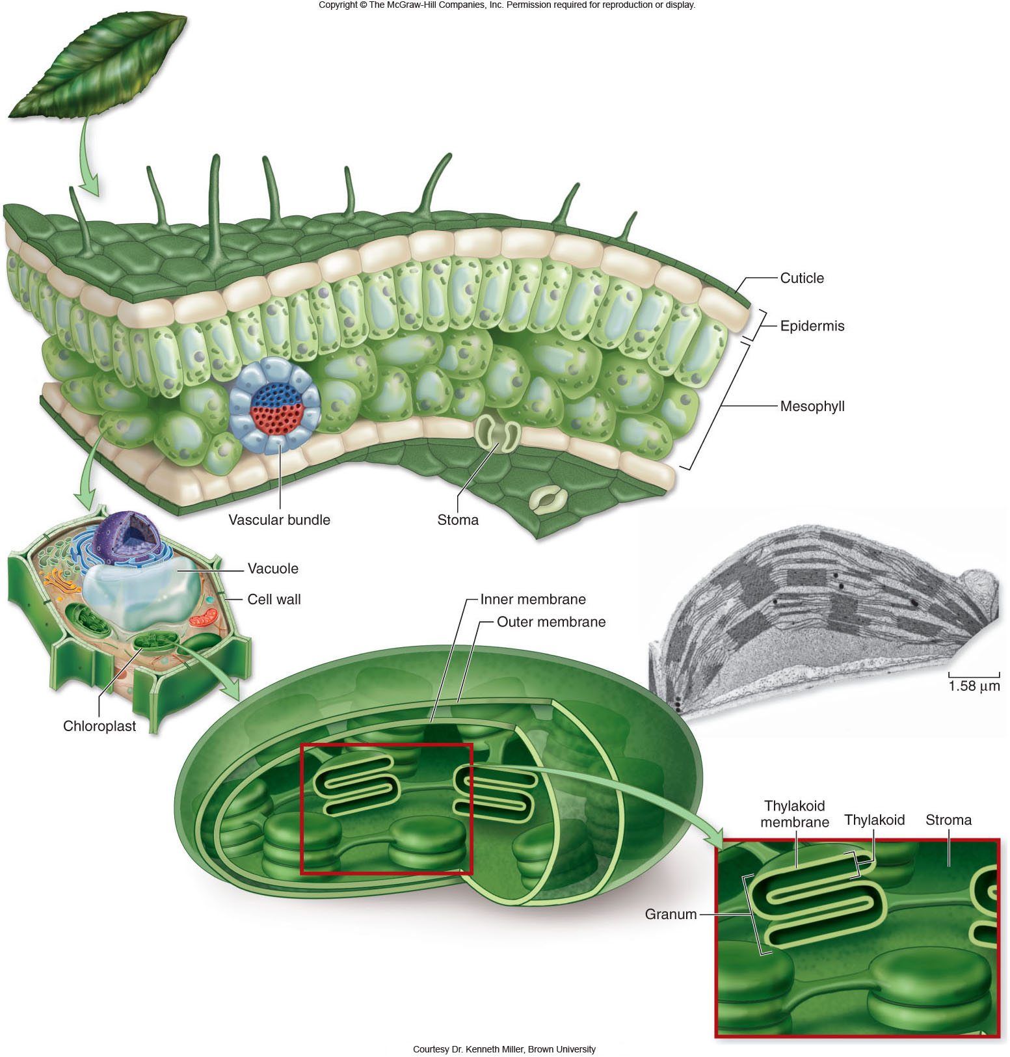

Slide 72
Discovery of Photosynthesis
The work of many scientists led to the discovery of how photosynthesis works.
Jan Baptista van Helmont (1580-1644)
Joseph Priestly (1733-1804)
Jan Ingen-Housz (1730-1799)
F. F. Blackman (1866-1947)

Slide 73
Discovery of Photosynthesis
C. B. van Niel, 1930’s
-proposed a general formula:
CO₂+H₂A + light energy CH₂O + H₂O + 2A
where H₂A is the electron donor
-van Niel identified water as the source of the O₂ released from photosynthesis
-Robin Hill confirmed van Niel’s proposal that energy from the light reactions fuels carbon fixation

Slide 74
Pigments
photon: a particle of light
-acts as a discrete bundle of energy
-energy content of a photon is inversely proportional to the wavelength of the light
photoelectric effect: removal of an electron from a molecule by light
-occurs when photons transfer energy to electrons

Slide 75
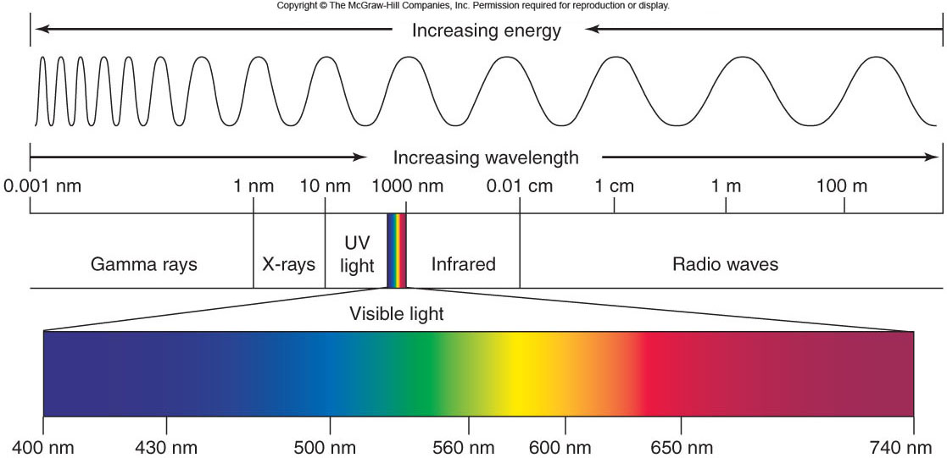

Slide 76
Pigments
Pigments: molecules that absorb visible light
Each pigment has a characteristic absorption spectrum, the range and efficiency of photons it is capable of absorbing.

Slide 77
Dark Reaction (Calvin Cycle)
Does not need light but can occur in the light.
Uses CO₂ and ATP & NADPH to form PGAL, to form Glucose (sugar).
Calvin Cycle:
CO₂ enters the cycle and combines with a 5 carbon compound. This forms a 3 carbon compound.
Energy from 12 ATP and 12 NADPH change the 3 carbon compound to PGAL, and 12 ADP and 12 NADP.
PGAL is then converted to make glucose.
This cycle must go around 6 times to make glucose.

Slide 78
Light Reaction
Light is required for this to happen
Energy from the sun is used to converted to the energy storing compounds ATP & NADPH.
Photosynthesis takes place in the Thylakoid membrane in the Granum inside the chloroplasts.
Inside the chloroplasts is the photosynthetic membrane which contain the chlorophyll.

Slide 79
Light Reaction
Steps to make Energy Compounds:
Photosynthetic Membrane has a photo system that captures the suns energy.
Two types of photosystems, Photosystem I & photosystem II.
The chlorophyll and other accessory pigments capture the light. ( Water is split here, releasing hydrogen’s and making free O2.)
Energy is transferred through the pigments until it reaches the reaction center.
Electrons are then released and passed to the first of many carriers. These carriers are called the electron transport chain.
Electrons are carried to NADP and converted into NADPH. This is then stored and used in the Dark Reaction.

Slide 80
Pigments: molecules that absorb visible light
Each pigment has a characteristic absorption spectrum, the range and efficiency of photons it is capable of absorbing.

Slide 81
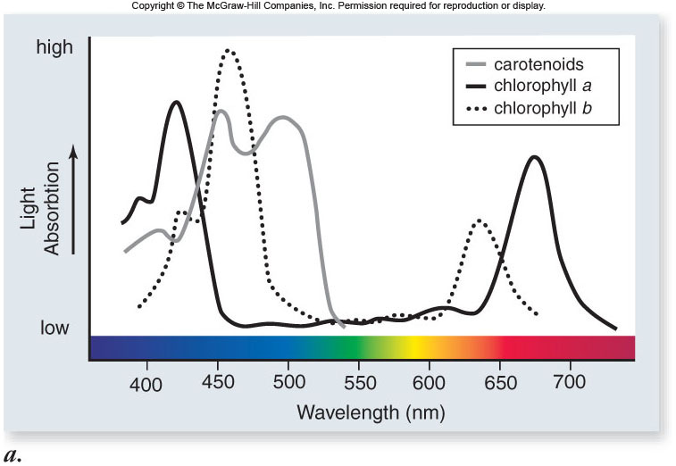

Slide 82
chlorophyll a – primary pigment in plants and cyanobacteria
-absorbs violet-blue and red light
chlorophyll b – secondary pigment absorbing light wavelengths that chlorophyll a does not absorb

Slide 83
accessory pigments: secondary pigments absorbing light wavelengths other than those absorbed by chlorophyll a
-increase the range of light wavelengths that can be used in photosynthesis
-include: chlorophyll b, carotenoids, phycobiloproteins
-carotenoids also act as antioxidants

Slide 84
Light-Dependent Reactions
Light-dependent reactions occur in 4 stages:
1. primary photoevent – a photon of light is captured by a pigment molecule
2. charge separation – energy is transferred to the reaction center; an excited electron is transferred to an acceptor molecule
3. electron transport – electrons move through carriers to reduce NADP⁺
4. chemiosmosis – produces ATP

Slide 85
In sulfur bacteria, only one photosystem is used for cyclic photophosphorylation
1. an electron joins a proton to produce hydrogen
2. an electron is recycled to chlorophyll
-this process drives the chemiosmotic synthesis of ATP

Slide 86
Photosynthetic Membrane has a photo system that captures the suns energy.
Two types of photosystems: Photosystem I & photosystem II.
The chlorophyll a, chlorophyll b and other accessory pigments capture the light. ( Water is split here, releasing hydrogen’s and making free O2.)
Steps to make Energy Compounds:

Slide 87
Carbon Fixation Reactions
To build carbohydrates, cells need:
1. energy
-ATP from light-dependent reactions
2. reduction potential
-NADPH from photosystem I

Slide 88
Dark Reaction (Calvin Cycle)
Calvin cycle
-biochemical pathway that allows for carbon fixation
-occurs in the stroma
-uses ATP and NADPH as energy sources
-incorporates CO₂ into organic molecules

Slide 89
Dark Reaction (Calvin Cycle)
Does not need light but can occur in the light.
Uses CO₂ and ATP & NADPH to form PGAL, to form sugar.
Calvin Cycle:
CO₂ enters the cycle and combines with a 5 carbon compound. This forms a 3 carbon compound.
Energy from 12 ATP and 12 NADPH change the 3 carbon compound to PGAL, and 12 ADP and 12 NADP.
PGAL is then converted to make glucose.
This cycle must go around 6 times to make glucose.

Slide 90
Glucose is not a direct product of the Calvin cycle.
-2 molecules of G3P leave the cycle
-each G3P contains 3 carbons
-2 G3P are used to produce 1 glucose in reactions in the cytoplasm

Slide 91
During the Calvin cycle, energy is needed. The energy is supplied from:
- 18 ATP molecules
- 12 NADPH molecules

Slide 92
The energy cycle:
-photosynthesis uses the products of respiration as starting substrates
-respiration uses the products of photosynthesis as starting substrates

Slide 93
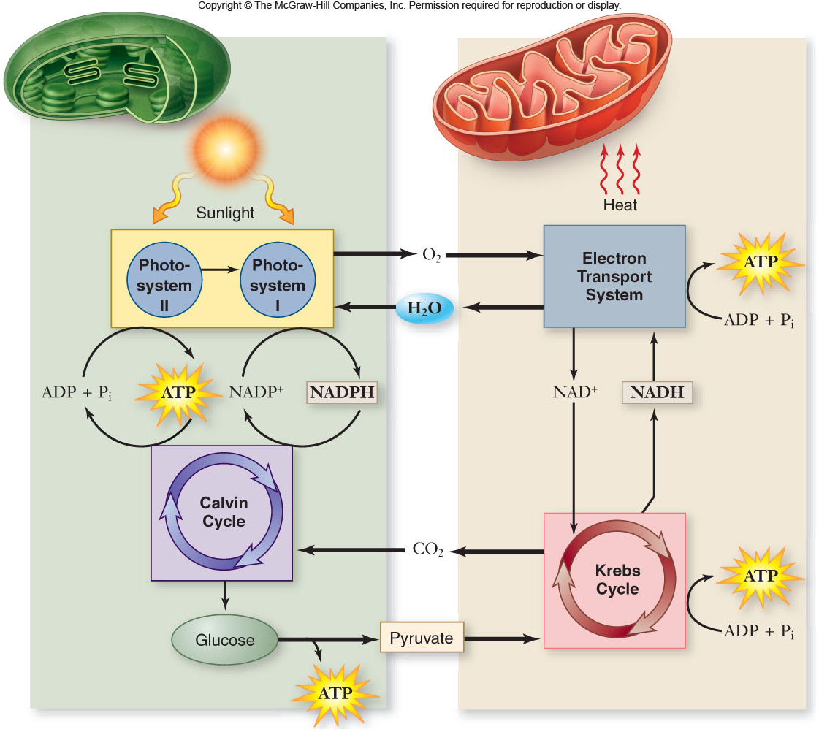

Slide 94
Reactions
Respiration
C₆H₁₂O₆ + 6O₂--------- 6CO₂ + 6H₂O + 6O₂
Photosynthesis
6CO₂ + 6H₂O + 6O₂ -------- C₆H₁₂O₆ + 6O₂

